Slide 1

Quick-mart
1.Meet Bohra :- 20104057
2.Shivam Gupta :- 20104110
3.Yashab Mahimi :- 20104026
Project Guide
Ms. Geetanjali Kalme
Notes:
1

Slide 2
Contents
Introduction
Objectives
Scope
Literature Review
Proposed System
Project Outcomes
Flowchart
DFD
Technology Stack
Suggestions in Review-1
Result and Discussion
Conclusion and Future Scope
References
Notes:
2

Slide 3
1. Introduction
Quick-mart is a web app which allows consumers to directly buy goods or services from a seller over the Internet using a web browser or a mobile app.
Problem Identified :
The traditional way of buying goods/products is the customer need to go to the market, where he/she has to search for the products which consumes a lot of time then check the quality and then wait for billing which consumes customer valuable time and effort.
Proposed solution :
Saves customers time and efforts.
Provide hassle-free services to customers.
Wide variety of products are available.
Get detailed information of products.
Notes:
3

Slide 4
2. Objectives
To provide a user-friendly interface with dynamic features.
To provide user options to make their account and order the goods of their needs.
To provide user a option to set the desired language.
To increase efficiency of order and delivery.
To manage safe payments for the customers.
To provide verification of order to users through mail.
Notes:
4

Slide 5
3. Scope
User get a 24*7 service.
We will Deliver product all over India.
Customers will be able to see the reviews of the Product.
Notes:
5

Slide 6
4. Literature Review
International Journal of Engineering Research & Technology (IJERT) http://www.ijert.org ISSN: 2278-0181 IJERTV9IS060267 (This work is licensed under a Creative Commons Attribution 4.0 International License.) Published by : www.ijert.org Vol. 9 Issue 06, June-2020
It characterizes the runtime behaviors on an evolving server-side application JavaScript, Node.js, compared to JavaScript's client-side code.
It has presented a comparative study of non-relational databases and relational databases.

Slide 7
5. Proposed System
Feature 1 :
Detailed information of products which will help customers in selecting which products to buy.
Feature 2 :
We have made a safe and trustable payment gateway for customers.
Feature 3 :
We have made app better and user friendly so customer will not face any issues.
Notes:
7

Slide 8
6. Outcome of Project
User will be able search for products/items.
User will be able select their desired language.
User will be able to view information of products available.
User will be able to order and do safe online payment.
User will get Email verification.
User will be able to track the status of the delivery.
Notes:
8

Slide 9
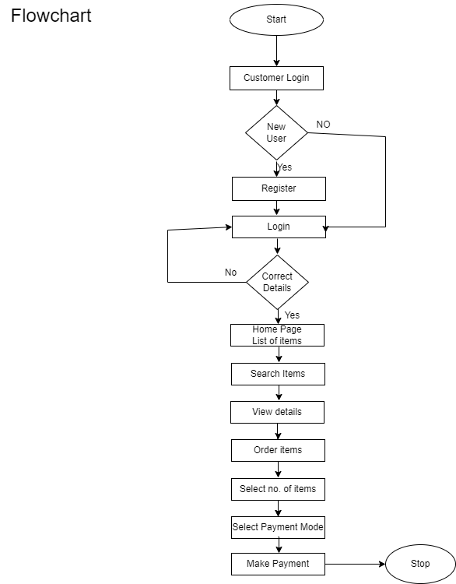

Slide 10
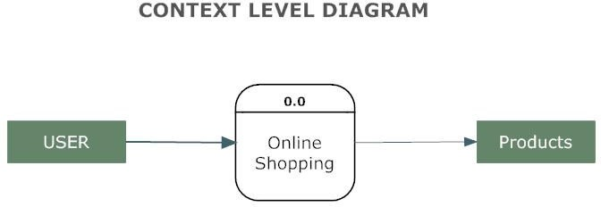
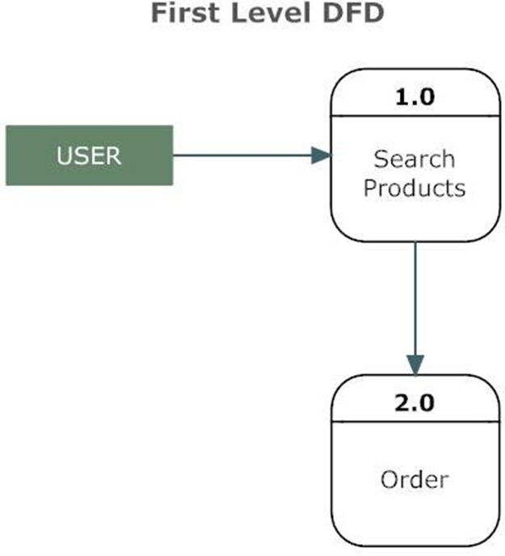
8.Data Flow Diagram

Slide 11
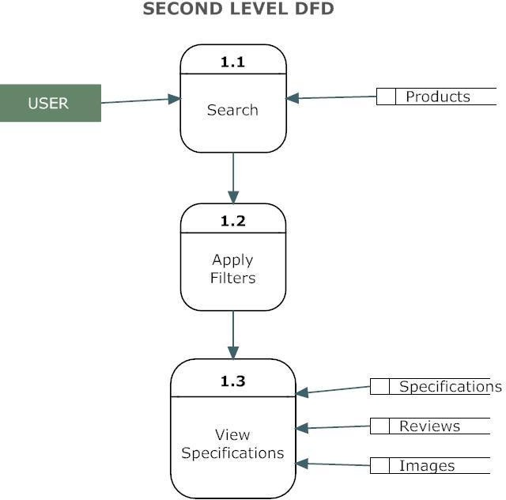
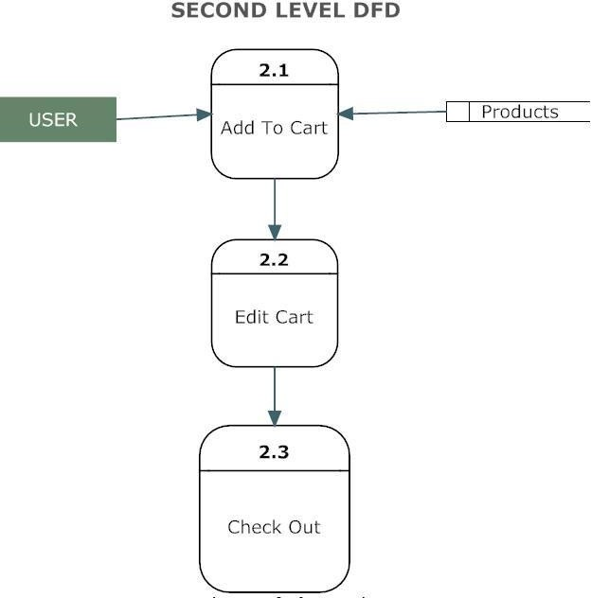
8.Data Flow Diagram

Slide 12
9.Technology Stack
Frontend: Backend:
HTML NODE JS
CSS MONGODB
JAVASCRIPT
BOOTSTRAP

Slide 13
10. Suggestions in Review-1
Media Query
Email Verification (SMTP).
CSS in Description Page.
Cart Page Scripting.

Slide 14
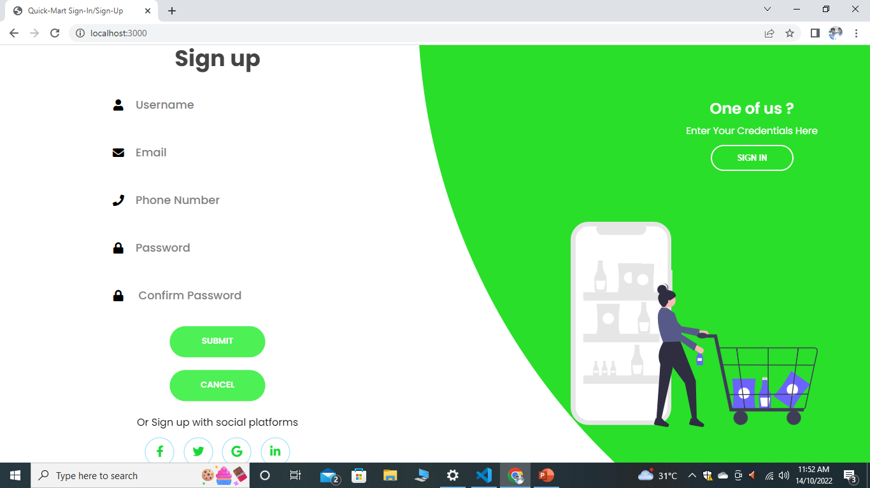
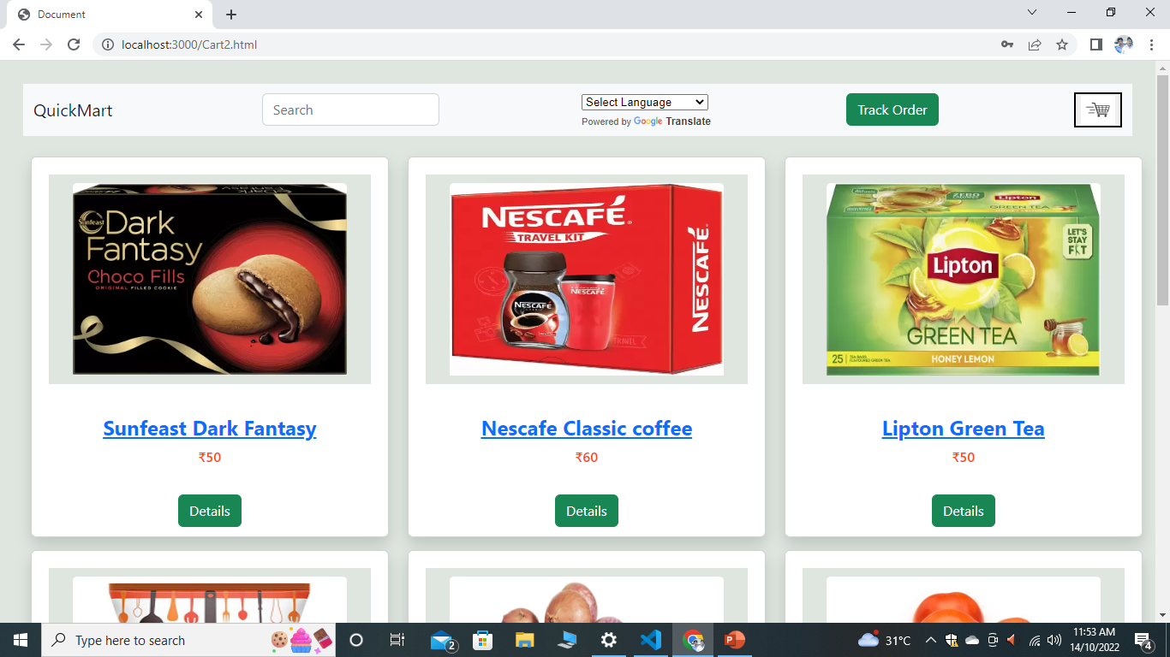
11. Result and Discussion
Sign in and sign up page.
Homepage: User will be able to view the products.

Slide 15
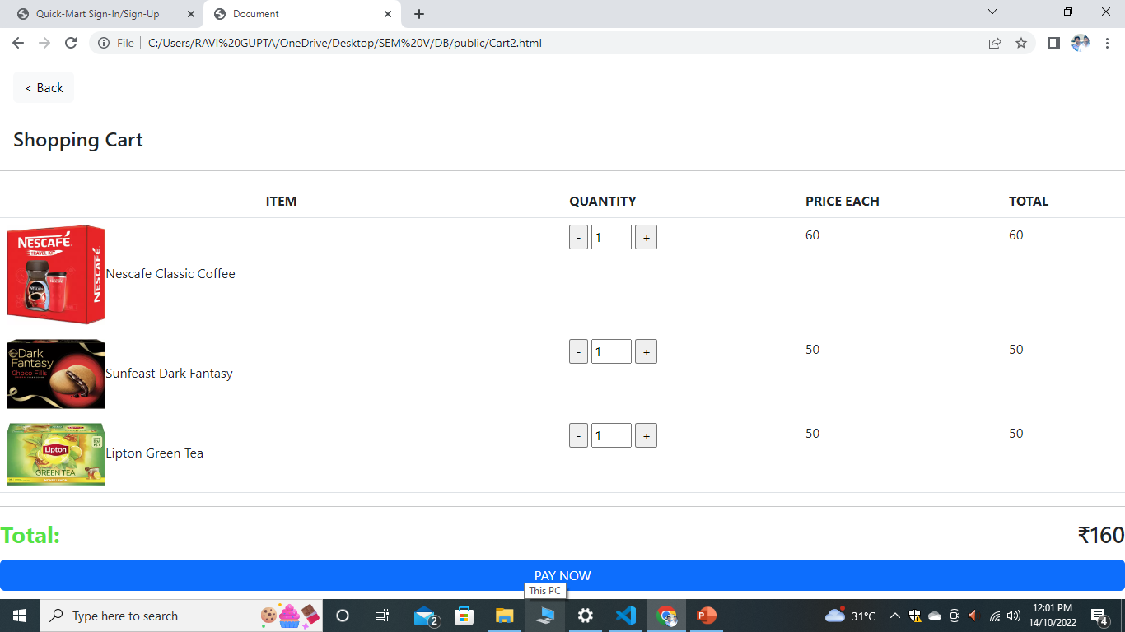
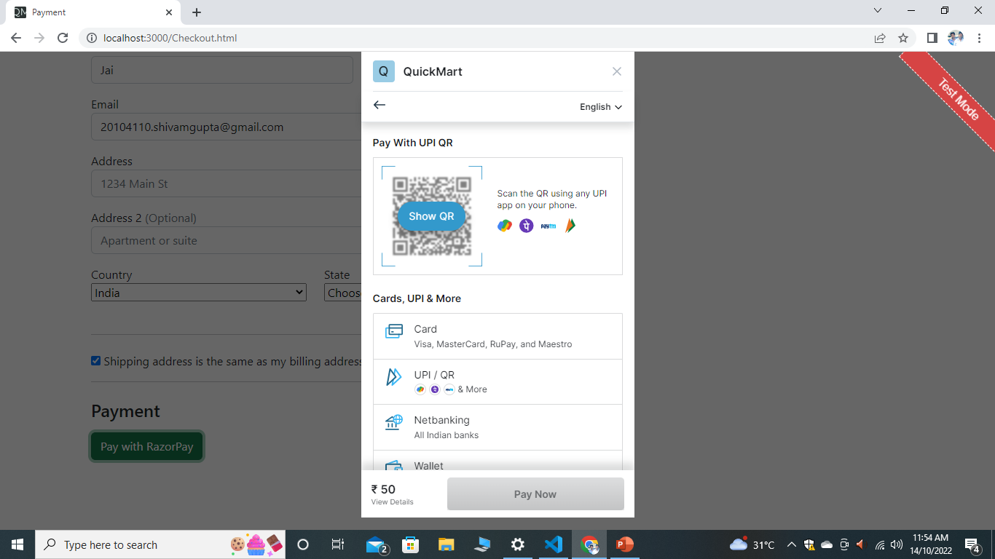
Cart Page: Selected products will be shown in cart page.
Payment Page: User will be able to do to do safe payment.

Slide 16
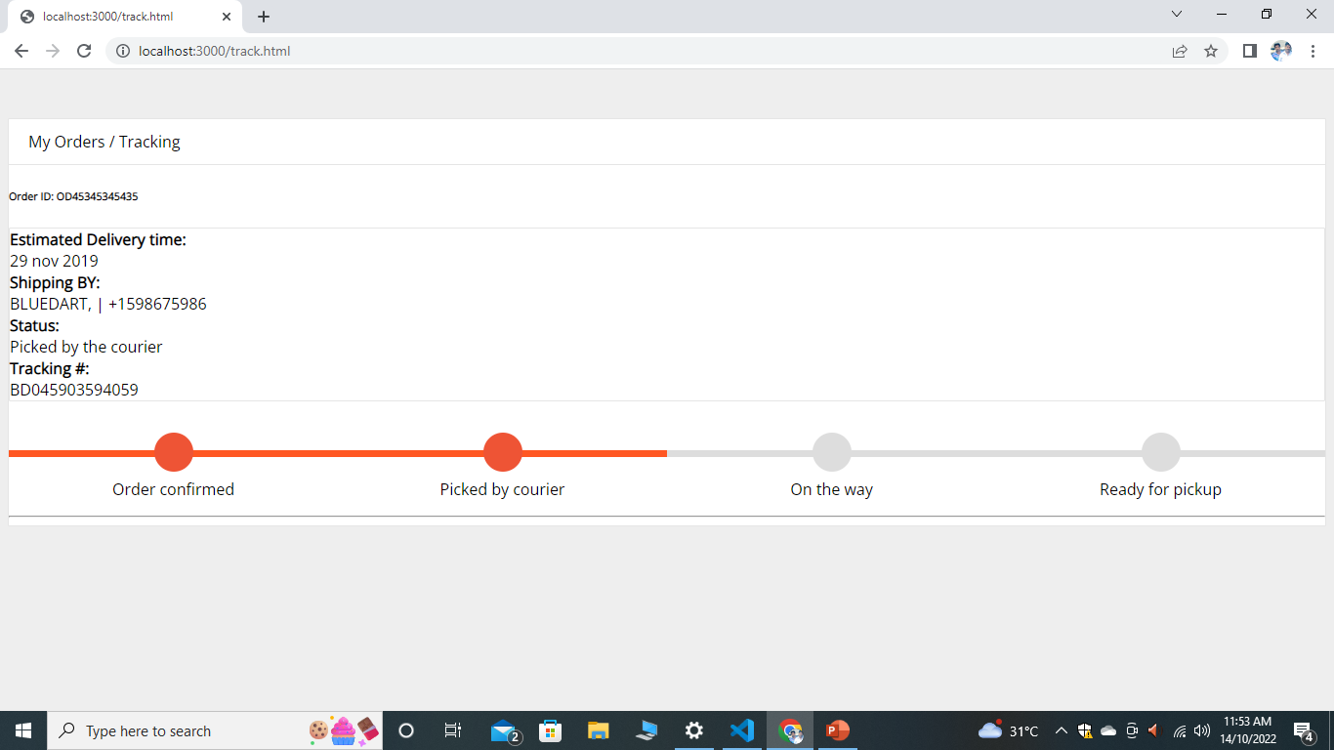
Order tacking page: User will be able to do track orders.

Slide 17
12. Future Scope
Prime Subscription
Where the user having prime subscription will be benefitted by fast delivery, early offers and many more.
Vouchers and Gift Cards
Where after successful payment the customers will get scratch card in which they will get amazing gift winning opportunity.

Slide 18
References
International Journal of Engineering Research & Technology (IJERT) http://www.ijert.org ISSN: 2278-0181 IJERTV9IS060267
“Express supervision system based on NodeJS and MongoDB”, 2017 IEEE/ACIS 16th International Conference on Computer and Information Science (ICIS).
“MongoDB scheme analysis” 2017 IEEE 21st International Conference on Intelligent Engineering Systems (INES).
https://getbootstrap.com/docs/4.1/getting-started.com
https://cloud.google.com/translate
https://razorpay.com/docs/api

Slide 19
Thank You...!!
Notes:
19

